Slide 1
Embedded Learning Multi-Domain Convolutional Neural Networks for Visual Tracking
CSED499I
20080650 CSE
Jeongbin Choe
Advisor: Prof. Bohyung Han (CV Lab)

Slide 2
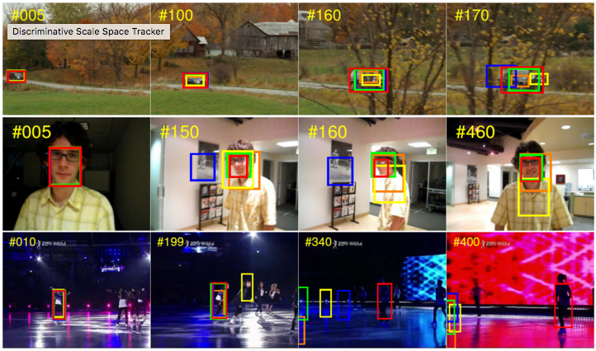
Visual Tracking
Locating, identifying and determining the dynamic configuration of moving objects
Frame by frame process

Slide 3
Convolutional Neural Network
Deep (Multi-layer) neural network
Convolution layer & Pooling layer
Applied to various computer vision tasks

Slide 4
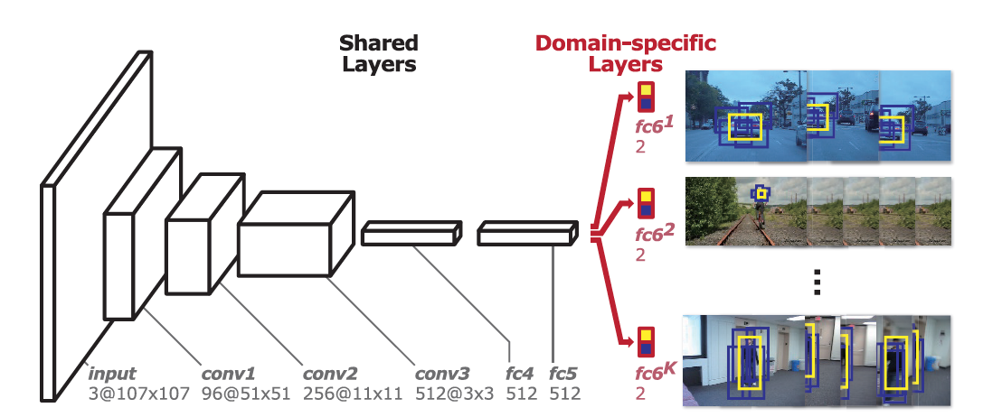
MDNet
Multi-Domain Network
Consists of shared layers and multiple branches of domain-specific layers
Domains correspond to indiv. training sequences
The winner of The VOT2015 Challenge

Slide 5
MDNet - Running Environment
1 fps with 8 cores Intel Xeon Processor + NVIDIA Tesla GPU
What about on Mobile devices?
₩1,500,000
₩1,800,000

Slide 6
Purpose and Goal
On iPhone6+ (Apple A8 processor: Dual-core 1.4 GHz Typhoon, PowerVR GX6450)
To keep around 1 fps and minimize loss of accuracy with every possible optimization
To implement real-time visual tracking application with a camera if time is available

Slide 7
Methods
Optimize the process
To improve by incorporating convex optimization
To reduce the size of input or the number of layers
To remove online tracking process
Use DeepLearningKit
Deep learning framework supporting CNNs for iOS
Developed in Swift and Metal
Use Objective-C/Swift

Slide 8
Schedule
Mar. 23 | Understanding the topic
Mar. 30 | Requirements analysis
Apr. 13 | High-level design
Apr. 27 | Prototype implementation
May. 04 | Detailed design
May. 27 | Optimization implementation
Jun. 03 - 07 | Submitting Final report
End of the semester | Poster presentation

Slide 9
References
Hyeonseob Nam and Bohyung Han, Learning Multi-Domain Convolutional Neural Networks for Visual Tracking, arXiv, 2015.
Y. Wu, J. Lim, and M. Yang. Object tracking benchmark. TPAMI, 2015.
http://acsweb.ucsd.edu/~yuw176/report/ECE273.pdf
http://www.votchallenge.net/vot2015
http://deeplearningkit.org

Slide 10
Thank you

